Slide 1
Schema for Open Access Policies
Mafalda Picarra

Slide 2
Overview
OA policy landscape
Rationale for developing a policy schema
An overview of the schema
How to complete the schema
Preliminary findings
Initial conclusions
Next steps

Slide 3
OA policy landscape
OA policy landscape is complex: institutions, funders, publishers
Policies are often expressed in different terms and conditions
Authors find challenges complying with multiple policies
Academic support staff find challenges providing advice, monitoring, and reporting on compliance
Data source: SHERPA/Juliet and ROARMAP

Slide 4
Rationale for developing a policy schema
Harmonised policies can simplify compliance workflows
Funders and institutions can express their policies in a consistent and structured way
Authors can more easily access information that is documented in a systematic way and receive clear guidance
Services can improve the quality and reliability of their data (e.g. SHERPA/Juliet)
Services can more easily mesh policy requirements with permissions (e.g. Sherpa FACT, Sherpa REF)

Slide 5
An overview of the schema
Five sections:
Organisation: details of the organisation issuing the policy
Policy: general parametric information
Repository requirements: requirements for depositing items and for making the deposited items OA
OA publishing requirements: requirements for publishing in OA form
Other: further information

Slide 6
An overview of the schema
Organisation: details of the organisation issuing the policy
Organisation
Name of organisation issuing the policy
Identifier for the organisation
Type of organisation
Link to organisation
What kinds of items does the policy cover?
Country or region in which the organisation is based

Slide 7
An overview of the schema
Policy: general parametric information
Policy
Link to policy on organisation's website
Link to policy in ROARMAP
Link to funder policy in SHERPA/JULIET
Date the policy was issued
Is the policy current or archived?
Policy start date
To whom does the policy apply?

Slide 8
An overview of the schema
Repository requirements: requirements for depositing items
Deposit of items
Deposit in a repository?
Deposit is required or a recommended?
Are deposit exemptions allowed?
Is deposit required for eligibility in research performance evaluation?
What kinds of items does the policy cover?
Which version of the item is to be deposited?
When to deposit?

Slide 9
An overview of the schema
Repository requirements: requirements for making the deposited items OA
Making items OA
Making item OA is required or recommended?
When to make deposited item OA?
Is making deposited item OA a condition for evaluation?
What licence should be used for making the item OA?
Maximum allowable publisher embargo length
Are exemptions allowed to make deposited item OA?

Slide 10
An overview of the schema
OA publishing requirements: requirements for publishing in OA form
OA publishing
Can item be published in OA through a publisher?
Is OA publishing required or recommended?
Are exemptions allowed in OA publication?
Licences
What kinds of items does the policy cover?
Does the organisation fund any OA publication costs?
Are there conditions on use of the organisation’s OA publication funds?
Other conditions on use of the organisation's OA publication funds
Is OA publication required for eligibility in research performance evaluation?

Slide 11
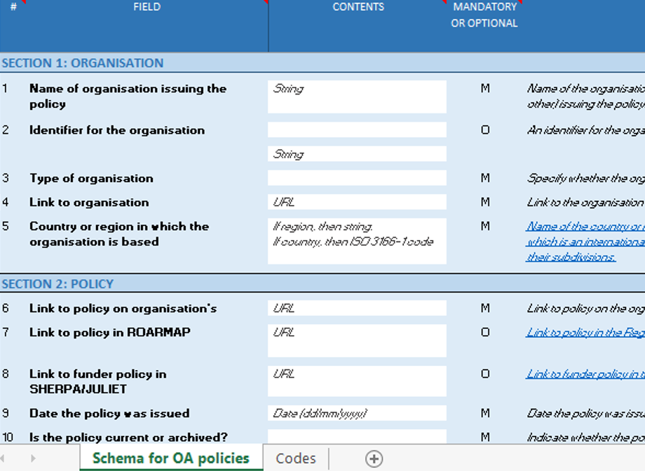
How to complete the schema
Field: usually a question for the organisation to answer
Contents: information to be provided by the organisation
Mandatory or Optional: whether the field must be filled in or if it may be left empty
Guidelines: further information to help the organisation provide the ‘contents’

Slide 12
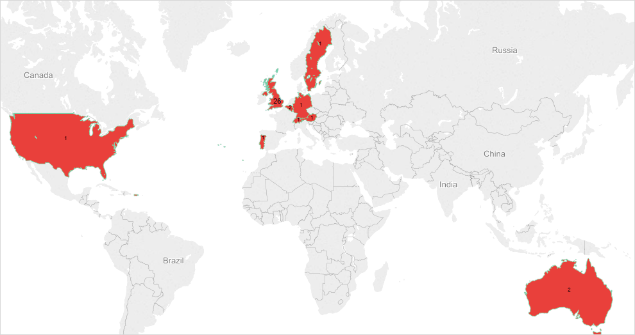
Preliminary findings
Schema completed by:
38 organisations
32 institutions
5 funders
1 institution and funder
10 countries
27 x UK
2 x Belgium
1 x Austria, Australia, Germany, Spain,
Sweden, Switzerland, Portugal, USA
Figure 1: Completed schemas by country

Slide 13
Preliminary findings: similarities
Major similarities between OA policies requirements:
Deposit in a repository (97%)
Deposit is required (87%)
Items covered include journal articles and conference proceedings (92%)
Version of deposit is the author's manuscript post-peer-review (76%)
Deposit in institutional repository (79%)
Making the deposited item OA (68%)
Policy does not specify that item is to be published OA through a publisher (84%)
The organisation funds any OA publication costs (63%)

Slide 14
Preliminary findings: similarities
Deposit in a repository
97% of OA policies make reference to depositing items in a repository

Slide 15
Preliminary findings: similarities
Depositing is required or recommended
87% of OA policies require the deposit of items

Slide 16
Preliminary findings: similarities
Items the policy covers
92% of OA policies cover both journal articles and conference proceedings

Slide 17
Preliminary findings: similarities
Version of item to be deposited
76% of OA policies require the author's manuscript post-peer-review as the item’s version to be deposited

Slide 18
Preliminary findings: similarities
Where to deposit
79% of OA policies require the deposit of items in institutional repositories

Slide 19
Preliminary findings: similarities
Making the deposited item OA
68% of OA policies require making the deposited items OA

Slide 20
Preliminary findings: similarities
Item published OA through a publisher
84% of OA policies do not specify if items have to be published OA through a publisher who makes it openly available immediately upon publication

Slide 21
Preliminary findings: similarities
Organisation funds any OA publication costs
63% of organisations fund OA publication costs (e.g. block grants, allowances in project budgets, dedicated institutional funds, or other methods)

Slide 22
Preliminary findings: differences
Major differences between OA policies requirements:
Exemptions to deposit
Depositing item is required for research evaluation
When to deposit item
When to make deposited item OA
Embargo length to make the deposited item OA
Exemptions to make the deposited item OA
Licence for making item OA
Licence for OA publishing

Slide 23
Preliminary findings: differences
Are exemptions to deposit allowed?
Significant variation between responses:
42% OA policies conditionally allow deposit exemptions
24% OA policies do not specify deposit exemptions
13% of OA policies do not allow deposit exemptions

Slide 24
Preliminary findings: differences
Depositing item is required for research evaluation
Variation between responses:
42% OA policies require deposit as part of research evaluation
37% OA policies do not require deposit as part of research evaluation
21% OA policies do not specify deposit as part of research evaluation

Slide 25
Preliminary findings: differences
When to deposit
Significant variation between responses:
37% OA policies require deposit dates that vary between immediately upon or up to x months from acceptance date
24% OA policies do not specify the deposit date
16% OA policies require deposit dates that vary between immediately upon or within x months from publication date

Slide 26
Preliminary findings: differences
When to make the deposited item OA
Significant variation between responses:
32% policies do not specify the date to make items OA
26% policies require items to be made OA as early as possible
16% policies require items to be made OA either immediately upon or within x months from publication date

Slide 27
Preliminary findings: differences
Embargo length to make the deposited item OA
Relative variation between responses:
71% unanswered questions
10% OA policies do not specify embargo length
8% OA policies apply 12 months embargoes

Slide 28
Preliminary findings: differences
Exemptions to make the deposited items OA
Significant variation between responses:
53% OA policies conditionally allow exemptions to make items OA
24% OA policies do not specify exemptions to make items OA
16% unanswered questions

Slide 29
Preliminary findings: differences
Licence for making item OA
Significant variation between responses:
55% OA policies do not specify the licence to make items OA
24% unanswered questions
18% OA policies require CC BY licence

Slide 30
Preliminary findings: differences
Licence for OA publishing
Significant variation between responses:
53% unanswered questions
31% OA policies do not specify the licence for OA publishing
16% OA policies require CC BY licence

Slide 31
Preliminary findings: cross-section analysis
Cross-section analysis between OA policies requirements:
Depositing item, making item OA and OA publishing
Exemptions
Eligibility in research performance evaluation
When to deposit and make item OA
Licences for making item OA and for OA publishing

Slide 32
Preliminary findings: cross-section analysis
Depositing item, making item OA and OA publishing
OA policies are clearly expressed in the requirements to deposit and make items OA
However, OA policies are not clear on OA publishing requirements, 53% do not specify this requirement and 21% do not provide information in this field
Table 1: Open Access: requirement or recommendation?

Slide 33
Preliminary findings: cross-section analysis
Exemptions
OA policies are relatively consistent in terms of conditionally allowing exemptions to deposit and to make items OA
However, a relevant proportion of OA policies still do not specify or do not provide information on the exemptions to deposit and to make items OA
Importantly, the significant majority of responses were not answered on the exemption to OA publishing (76%) and a relevant percentage do not specify (21%) this criteria
Table 2: Open Access: exemptions

Slide 34
Preliminary findings: cross-section analysis
Eligibility in research performance evaluation
42% and 24%, respectively, of OA policies specify that depositing or making items OA is a condition for eligibility in research performance evaluation
However, a relevant percentage of OA policies do not specify or do not provide information on depositing/making item OA/ OA publishing as a condition for eligibility in research performance evaluation
Importantly, a significant number of responses show that depositing/making item OA/ OA publishing is not a condition for eligibility in research performance evaluation
Table 3: Open Access: eligibility in research performance evaluation

Slide 35
Preliminary findings: cross-section analysis
When to deposit and make item OA
On deposit date, OA policies are relatively consistent in terms of requiring items to be deposited immediately or within x months after date of acceptance, however, they do not specify a value for x
On date to make items OA, policies are also relatively consistent in requiring items to be made OA as early as possible
However, there is substantial diversity in responses provided with regards to the applicable deposit dates and dates to make items OA
Importantly, a significant percentage of responses were not answered for these criteria
Table 4: Open Access: when to deposit and make OA

Slide 36
Preliminary findings: cross-section analysis
Licences
A relative percentage of OA policies specify that CC BY is the licence type to be used when making items OA (18%) or for OA publishing (16%)
The significant majority of OA policies, however, do not specify or do not provide information on the licence type that should be used to make items OA or for OA publishing
Table 5: Open Access: licences

Slide 37
Initial conclusions
Initial results show similarities between OA policies in some requirements…
…but there are also significant differences in the ways OA policies are expressed in other requirements, which could benefit researchers and academic support staff if they were expressed more clearly and consistently:
Exemptions to a) deposit item, b) make item OA and c) publish OA
A) deposit item, b) make item OA and c) publish OA as a criteria for eligibility in research performance evaluation
Item deposit date
Date for making item OA
Embargo length
Licences for a) making item OA and b) for OA publishing

Slide 38
Next steps
Promoting the uptake of the schema by institutions and funders internationally
Inviting institutions and funders to send us the completed forms
Analysing results to observe level of similarities and differences between OA policies
Promoting a move towards a more standardised system where institutional, funders and publishers OA policies can be expressed in a more harmonised way

Slide 39
Thank you!
Mafalda Picarra
PASTEUR4OA Project Officer
mafalda.picarra@jisc.ac.uk

